Slide 1
Intelligent Classification of Rural Infrastructure Projects
CAPSTONE PROJECT
Presented By:
Name :Jayanthan P
College Name: DAYANANDA SAGAR ACADEMY OF TECHNOLOGY AND MANAGEMENT Department : COMPUTER SCIENCE AND ENGINEERING

Slide 2
OUTLINE
Problem Statement
Proposed System/Solution
System Development Approach
Algorithm & Deployment
Result (Output Image)
Conclusion
Future Scope
References

Slide 3
Problem Statement
The Pradhan Mantri Gram Sadak Yojana (PMGSY) is a flagship initiative by the Government of India aimed at providing all-weather road connectivity to rural and unconnected habitations. Over time, this program has evolved into multiple distinct phases and schemes such as PMGSY-I, PMGSY-II, RCPLWEA, each with varying objectives, financial structures, and project specifications.
As the volume of infrastructure projects increases, manual classification of projects into their respective PMGSY schemes becomes inefficient, error-prone, and unscalable. To enable better monitoring, transparent fund allocation, and effective policy evaluation, there is a growing need for an automated classification system.
This project aims to design, develop, and evaluate a machine learning model that can automatically classify road and bridge construction projects into their correct PMGSY scheme based on their physical and financial characteristics. The solution will leverage real-world project data and deploy the trained model using IBM Cloud Lite services, enabling intelligent decision support for planners, analysts, and government stakeholders.

Slide 4
Proposed Solution
1. Data Collection
Gather structured project data from AI Kosh and other relevant sources, including:
Physical attributes (road/bridge length, terrain)
Financial details (project cost, fund allocation)
Ensure that the dataset includes the PMGSY_SCHEME field as the classification label.
2. Data Preprocessing
Clean the data to handle missing values, inconsistencies, and anomalies.
Apply label encoding or one-hot encoding for categorical features (e.g., state, agency).
Normalize numerical features for uniformity (e.g., cost, length).
3. Machine Learning Algorithm
Implement classification models such as:
Random Forest
XGBoost
Logistic Regression
Neural Networks (if suitable)
Use cross-validation to ensure model generalizability.
Fine-tune hyperparameters for optimal performance.
4. Deployment
Develop a user-friendly interface or API that accepts project data and returns the predicted PMGSY scheme.
Deploy the model using IBM Cloud Lite services:
Use Watson Machine Learning for model hosting
Store data/model artifacts in IBM Cloud Object Storage
Optionally use Watson Studio for model training and visualization
5. Evaluation
Assess classification performance using metrics such as:
Accuracy
Precision, Recall, F1-score (per scheme)

Slide 5
System Approach
Hardware Requirements
Minimum 8 GB RAM (16 GB recommended)
Multi-core CPU (or GPU if training deep models)
Reliable internet connection (for IBM Cloud access and data integration)
Cloud Requirements
IBM Cloud Lite (Free tier)
IBM Watson Studio: for model development and training
IBM Cloud Object Storage: for storing raw data and trained models
IBM Watson Machine Learning: for model deployment and API generation
Libraries required for running the model =>
autoai-libs | 2.0.0
lale | 0.8.0
lightgbm | 4.2.0
numpy | 1.26.4
pandas | 2.1.4
scikit-learn | 1.3.0
scipy | 1.11.4
snapml | 1.14.5
xgboost | 2.0.3

Slide 6
Algorithm & Deployment
In the Algorithm section, describe the machine learning algorithm chosen for predicting bike counts. Here's an example structure for this section:
Algorithm Selection:
The Algorithms chosen are XGB Classifier and Snap Random Forest Classifier Algorithm. Among these the algorithm finally chosen was XGB classifier due to its accuracy after cross validation and it has undergone first parameter optimization and feature engineering .
Data Input:
The input features included State name , District name , No of road work sanctioned , No of bridge work sanctioned , No of road work completed , expenditure , No of bridges complete , No of roads complete , No of bridges balance , no of road work balance etc .
Training Process:
The multiclassification algorithm is used for univariate classification by convert the given data set to 90% of Training data set and 10 % test data set with Hyper parameter optimization , feature engineering and cross validation involved
Prediction Process:
The XGBoost classifier analyzes the input data, determines the relative importance of each feature, and accurately classifies the project into the appropriate scheme category based on learned patterns.

Slide 7
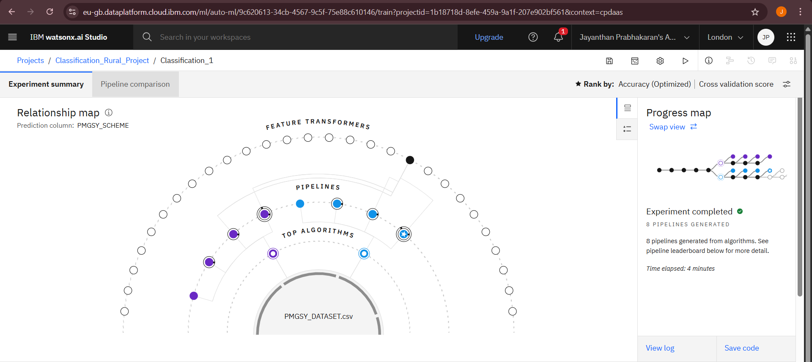
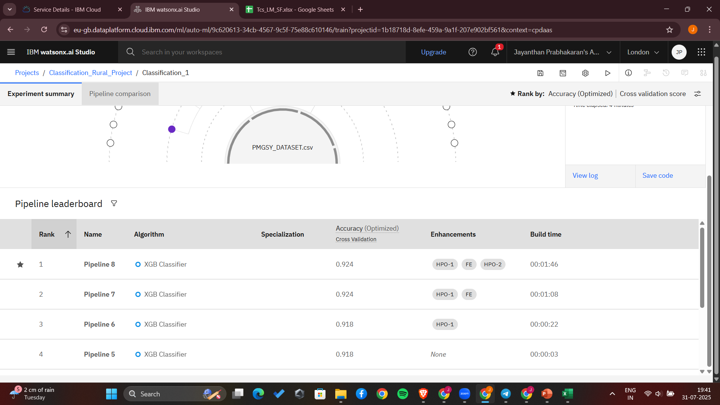
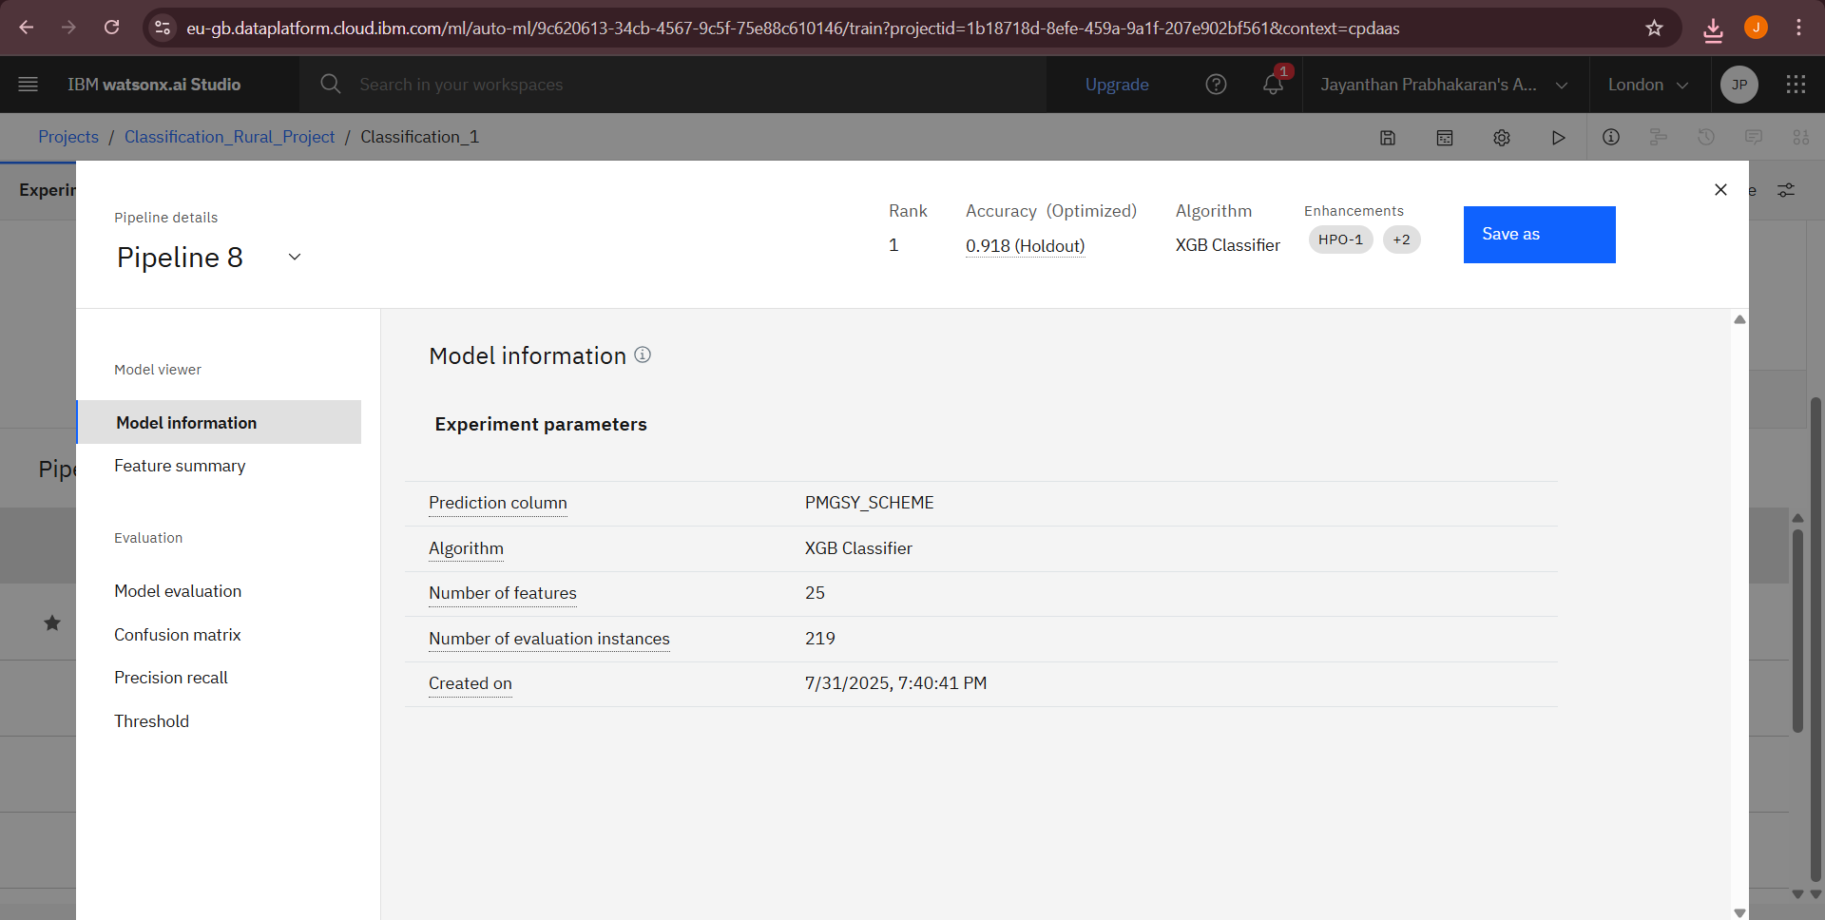
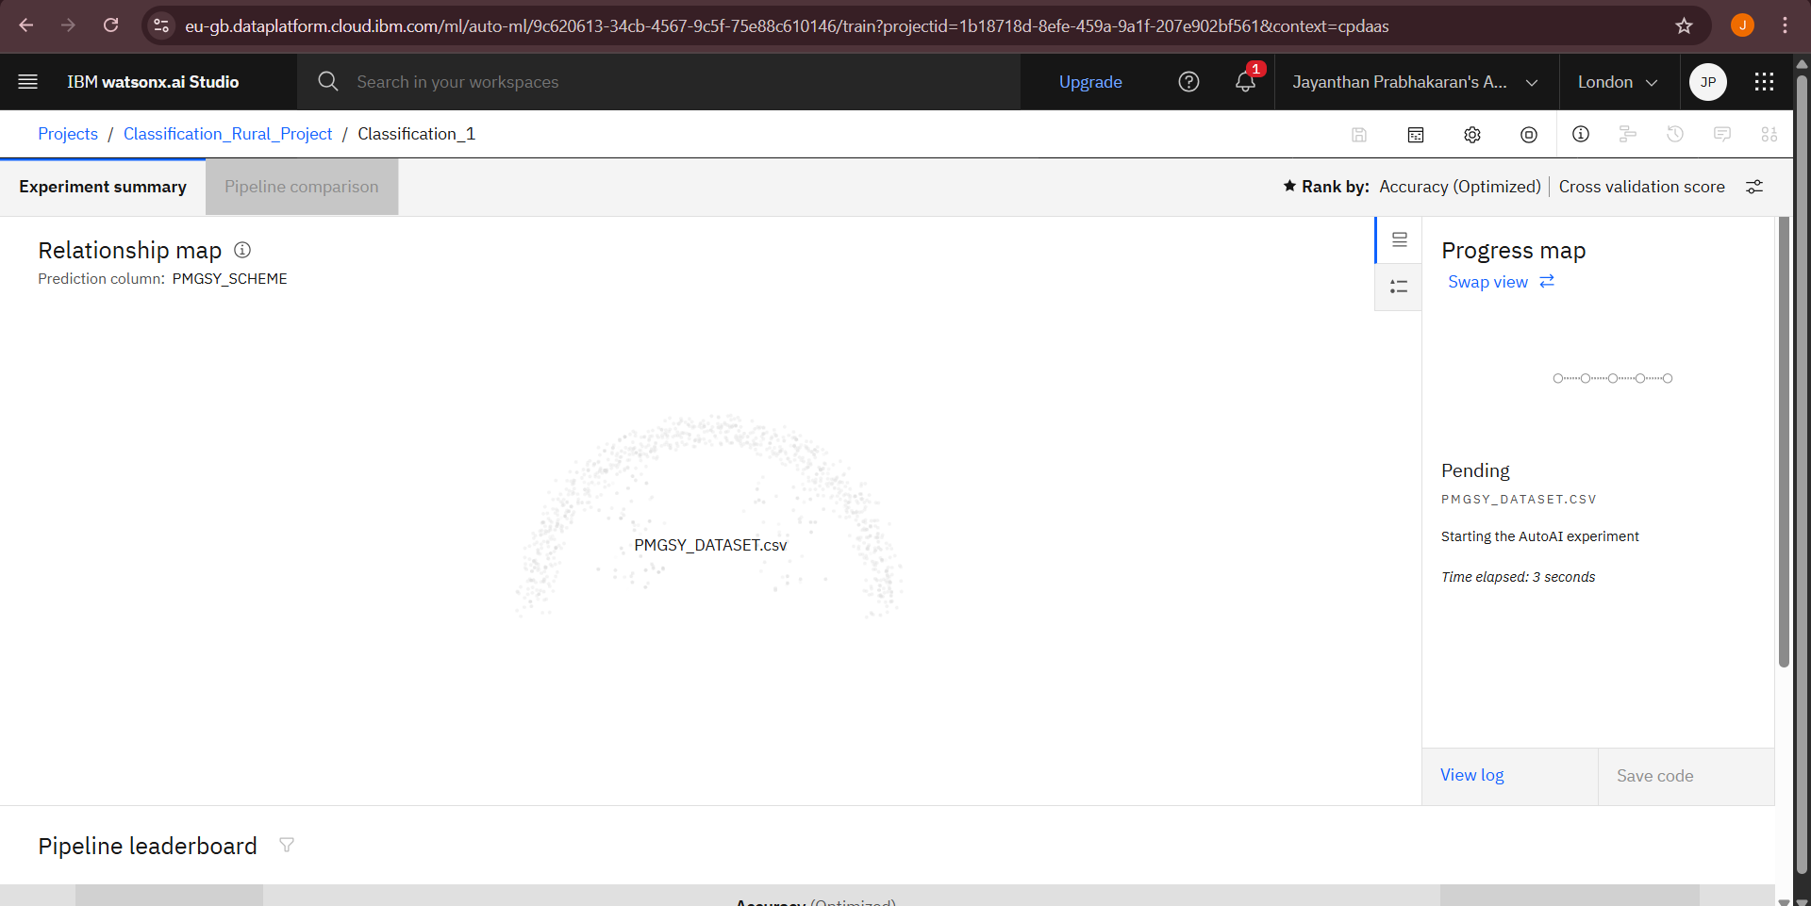
Result

Slide 8
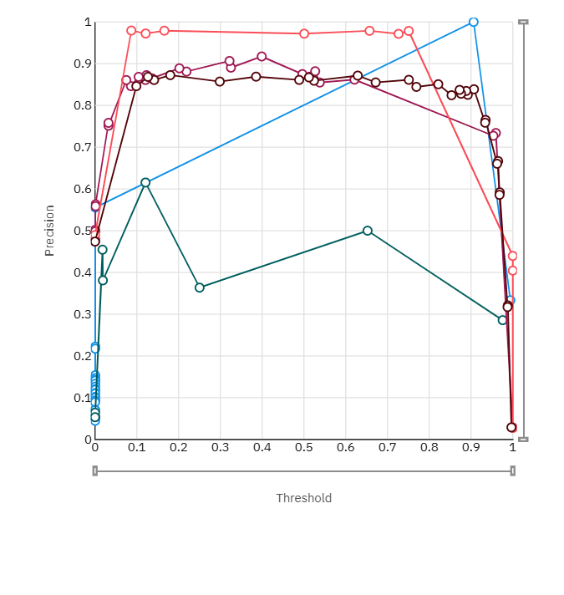
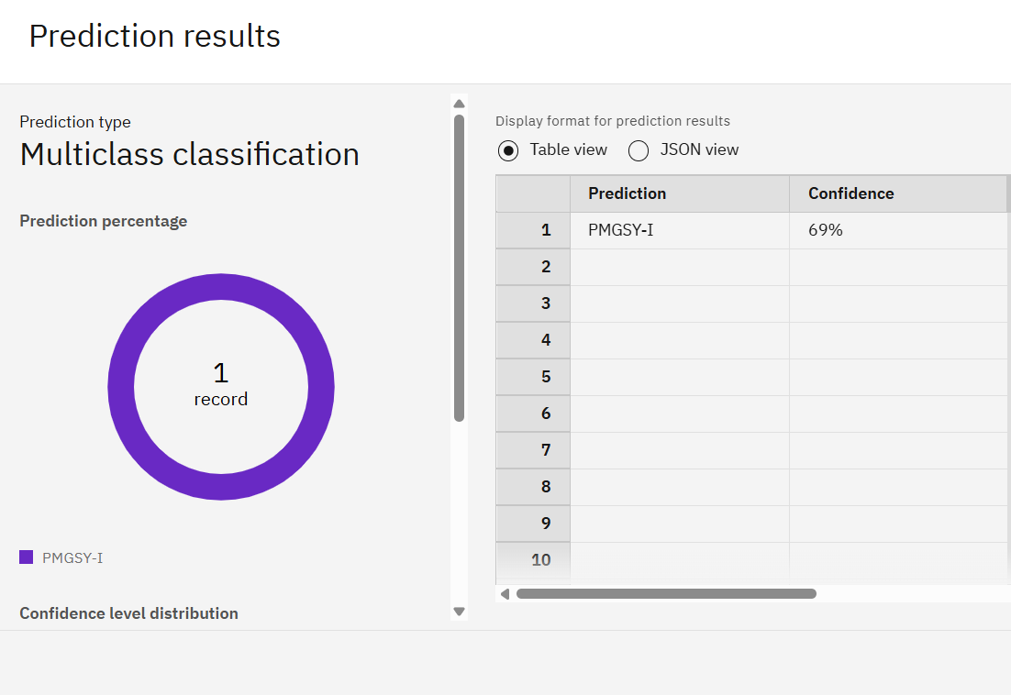
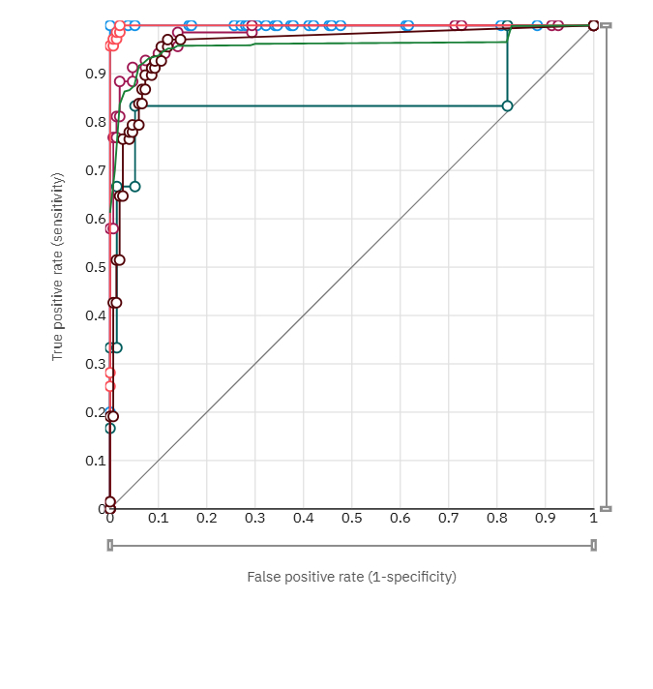
Result
Accuracy
Results

Slide 9
Conclusion
The implemented solution successfully demonstrates the potential of machine learning, particularly the XGBoost classifier, in automating the classification of rural infrastructure projects under various PMGSY schemes (PMGSY-I, PMGSY-II, RCPLWEA, etc.). By leveraging structured project data—such as physical attributes (e.g., road and bridge length), financial information (e.g., sanctioned cost), and temporal features (e.g., year of sanction)—the model was able to learn meaningful patterns and deliver high classification accuracy.
The XGBoost algorithm was chosen for its ability to handle both categorical and numerical data efficiently, as well as its robustness to overfitting. The model also provided insights into feature importance, helping identify which project characteristics most strongly influenced scheme classification. Evaluation metrics such as accuracy, precision, recall, and F1-score indicated strong performance across most classes, validating the model's effectiveness in real-world scenarios.

Slide 10
Future scope
Potential Improvements
Implement class balancing techniques (e.g., SMOTE or stratified sampling) to improve performance on underrepresented schemes.
Integrate external data sources such as geographical data, terrain type, or satellite imagery to enhance feature richness.
Develop a user-friendly dashboard for interactive model predictions and feature insights.
Explore ensemble approaches combining multiple models to increase robustness.
Continuously retrain the model using fresh project data to adapt to changing patterns in scheme allocation.

Slide 11
References
Chen, T., & Guestrin, C. (2016)XGBoost: A scalable tree boosting system.Proceedings of the 22nd ACM SIGKDD International Conference on Knowledge Discovery and Data Mining, 785–794. https://doi.org/10.1145/2939672.2939785,
PMGSY Dataset DocumentationOfficial dataset for PMGSY rural infrastructure projects https://aikosh.indiaai.gov.in/web/datasets/details/pradhan_mantri_gram_sadak_yojna_pmgsy.htmlPedregosa, F. et al. (2011)
Scikit-learn: Machine learning in Python.Journal of Machine Learning Research, 12, 2825–2830. https://jmlr.csail.mit.edu/papers/v12/pedregosa11a.htmlBrownlee,
XGBoost with Python: Gradient Boosted Trees for Machine Learning.Machine Learning Mastery. https://machinelearningmastery.com/gentle-introduction-xgboost-applied-machine-learning
IBM Cloud Documentation – Watson Machine Learning📌 Why important: Official deployment platform for your model. Guides model registration, deployment, and API creation within IBM Cloud Lite https://cloud.ibm.com/docs/watson-machine-learning,

Slide 12

IBM Certifications

Slide 13

IBM Certifications

Slide 14
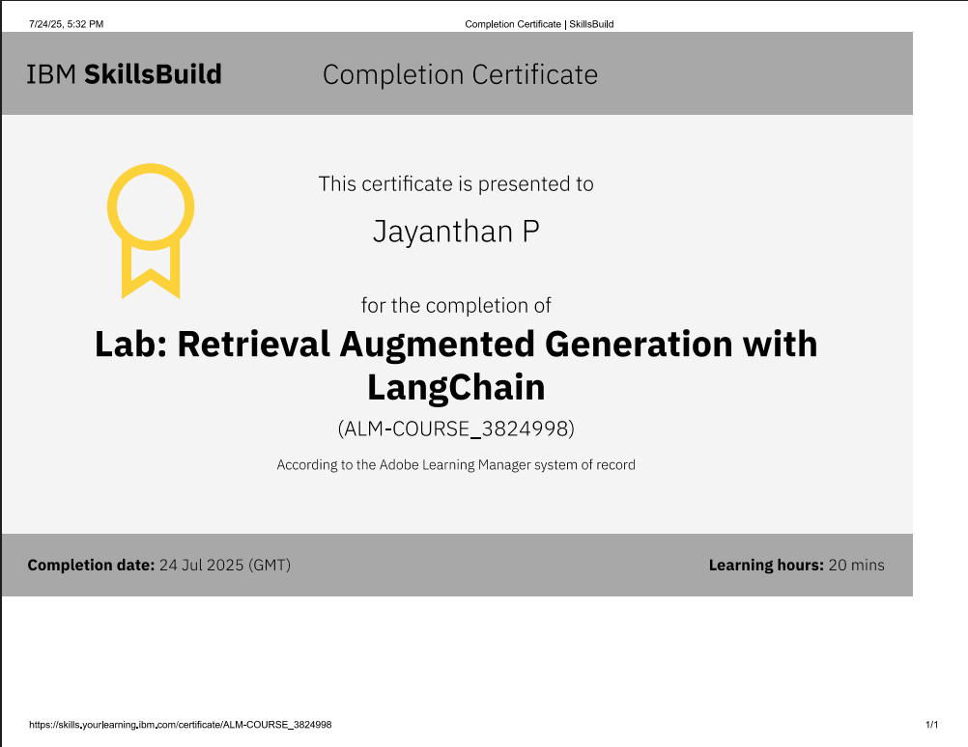
IBM Certifications

Slide 15
THANK YOU

